Slide 1
Stockholm Xamarin User Group SignalR och ModernHttpClient 2015-05-20
Peter Norman, XAML utvecklare på IT-HUSET som gått all in på Xamarin.Forms.

Slide 2
Agenda
Accessing servers
REST, RestSharp, HttpClient, etc.
ModernHttpClient
SignalR
SignalR and ModernHttpClient

Slide 3

ModernHttpClient
A fast HttpClient that uses the underlying native network handling through a NativeMessageHandler.
NativeMessageHandler also handles fast reconnection between WLAN and 3G/4G
https://github.com/paulcbetts/ModernHttpClient
https://www.nuget.org/packages/modernhttpclient

Slide 4

Building Real-Time Applications with ASP.NET SignalR
DEV-B343
Brady Gaster

Slide 5
SignalR is an abstraction that intelligently decides how to enable real-time over HTTP

Slide 6
SignalR on Modern Servers & Clients When WebSockets or some other real-time layer is supported
Server
I can party in real time. Can you?
Client
Let’s party in real time!
Yep, I can party in real time

Slide 7
SignalR on Old-school Servers & Clients When some lower-common denominator polling mechanism is needed
Server
Got Data?
Got Data?
Got Data?
Client
Got Data?
Here’s some data
Got Data?
Got Data?
Got Data?
Got Data?

Slide 8
SignalR Core Concepts
Hub
Backplane
Represents a simple endpoint for sending single-recipient, grouped, or broadcast messages
A backplane allows you to scale your application to multiple servers. With a backplane enabled, each application instance sends messages to the backplane, and the backplane forwards them to the other application instances.
A more high-level pipeline built upon the Connection API that allows your client and server to call methods on each other directly
Connection

Slide 9
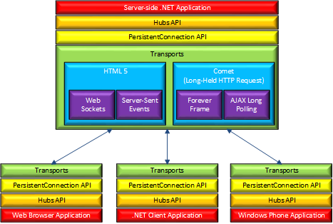
Picture was taken from http://www.asp.net/signalr
Architecture Diagram

Slide 10
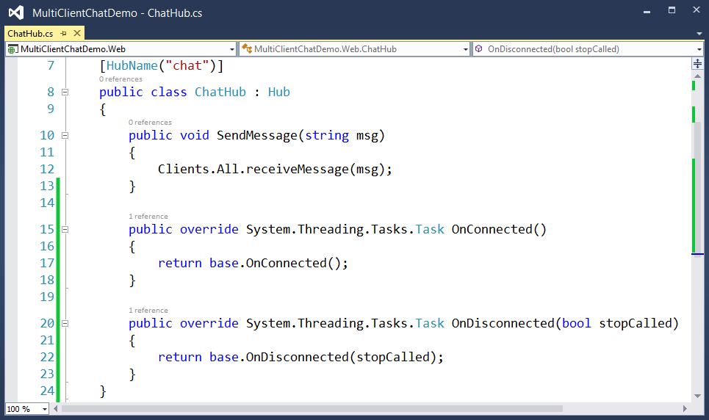
SignalR Hubs
Since Hubs are called on the client by name, the name can be customized if needed
A hub is a .NET class that inherits from
Microsoft.AspNet.SignalR.Hub
The Clients property of a Hub class exposes dynamic properties useful for targeting specific clients
Hub classes also have virtual methods useful for responding to connected/disconnected events

Slide 11
Sending messages to all connected clients
Clients.All.doWork()
Scott
Jon
Hub
Brady

Slide 12
Sending messages to the calling client
Clients.Caller.doWork()
Scott
Jon
Hub
Brady

Slide 13
Sending messages to other connected clients
Clients.Others.doWork()
Scott
Jon
Hub
Brady

Slide 14
Sending messages to specific users
Clients.Users(“Brady”).doWork()
Scott
Jon
Hub
Brady

Slide 15
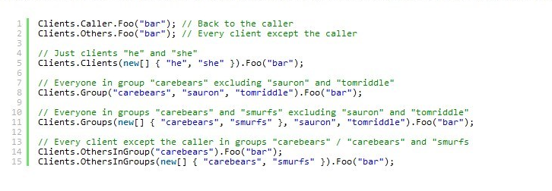
Sending messages to clients
http://magicaldebugging.com/signalr-xamarin/
From http://magicaldebugging.com/signalr-xamarin/

Slide 16
SignalR and ModernHttpClient
Demo

Slide 17
References
http://signalr.net
http://www.asp.net/signalr
https://github.com/paulcbetts/ModernHttpClient
https://channel9.msdn.com/Events/Ignite/2015/BRK3728
http://channel9.msdn.com/Events/TechEd/Europe/2014/DEV-B343

